Slide 1
School Choice
Part 1
INFO 4220 – Networks II: Market Design
Adapted from Haeringer Ch.13 & 14

Slide 2
School Choice
Many cities don’t let parents choose schools (other than by choosing where to live). But, in many cities, parents can express preferences
Matching models are used to give parents a choice over the school children will attend
Similar to a many-to-one assignment with some differences
  Standard case involves public schools. Thus, schools don’t have preferences over students
  Students may have priority at certain schools (i.e. schools have a priority ordering), but they rank all students (no student is unacceptable)
  Students may find some schools unacceptable (i.e. prefer home schooling or private schools)

Slide 3
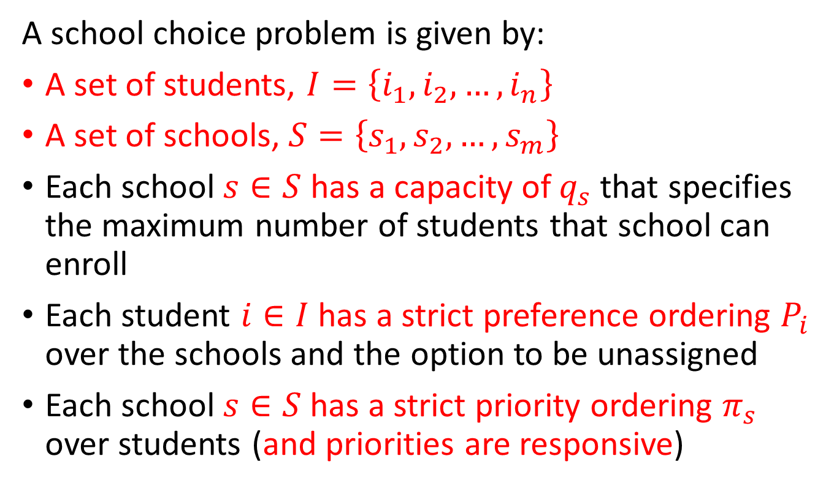
Definition – School Choice Problem
A school choice problem is given by:
A set of students, $I=\left\{i_{1},i_{2},…,i_{n}\right\}$
A set of schools, $S=\left\{s_{1},s_{2},…,s_{m}\right\}$
Each school $s∈S$ has a capacity of $q_{s}$ that specifies the maximum number of students that school can enroll
Each student $i∈I$ has a strict preference ordering $P_{i}$ over the schools and the option to be unassigned
Each school $s∈S$has a strict priority ordering $π_{s}$ over students (and priorities are responsive)

Slide 4
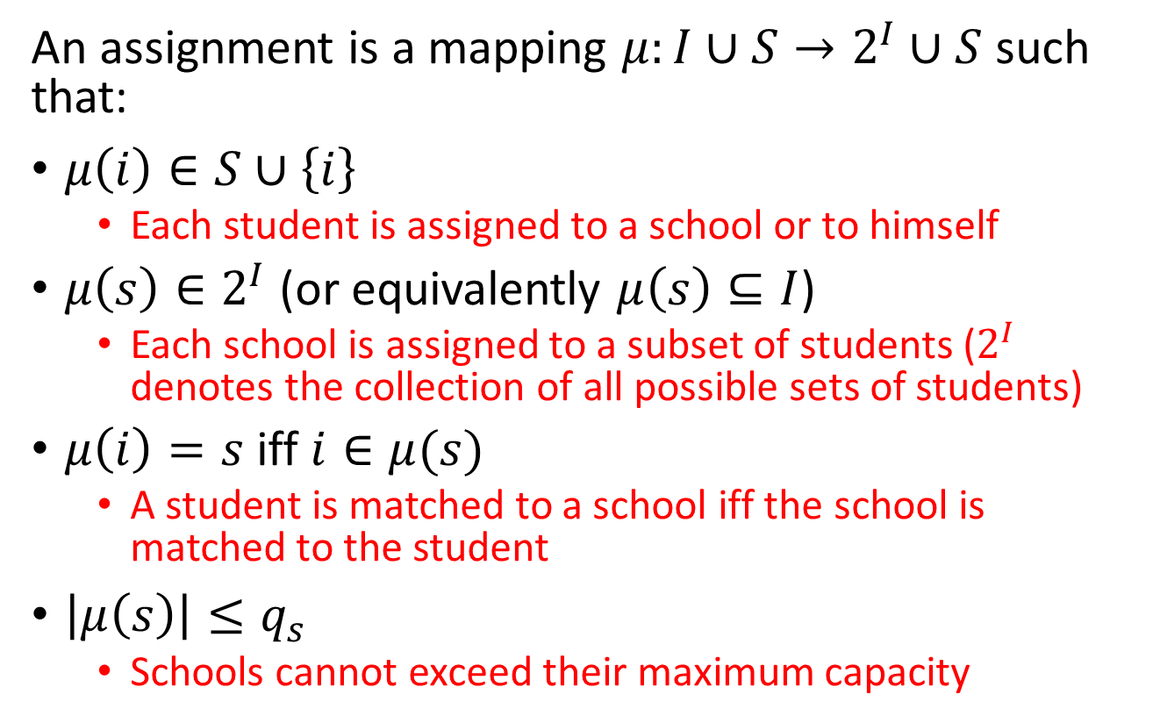
Definition – Assignment
An assignment is a mapping $μ:I∪S→2^{I}∪S$ such that:
$μ\left(i\right)∈S∪\left\{i\right\}$
  Each student is assigned to a school or to himself
$μ\left(s\right)∈2^{I}$ (or equivalently $μ\left(s\right)⊆I$)
  Each school is assigned to a subset of students ($2^{I}$ denotes the collection of all possible sets of students)
$μ\left(i\right)=s$iff $i∈μ(s)$
  A student is matched to a school iff the school is matched to the student
$\left|μ\left(s\right)\right|≤q_{s}$
  Schools cannot exceed their maximum capacity

Slide 5
Efficiency and Stability
Up to know we had said that:
  In matching problems, we wanted stability
  In assignment problems, we wanted efficiency
School choice problems are in a grey area
  Sometimes school districts will prefer algorithms that produce stable allocations
  Sometimes school districts will prefer algorithms that produce efficient allocations
We will discuss this with some examples towards the end of today

Slide 6
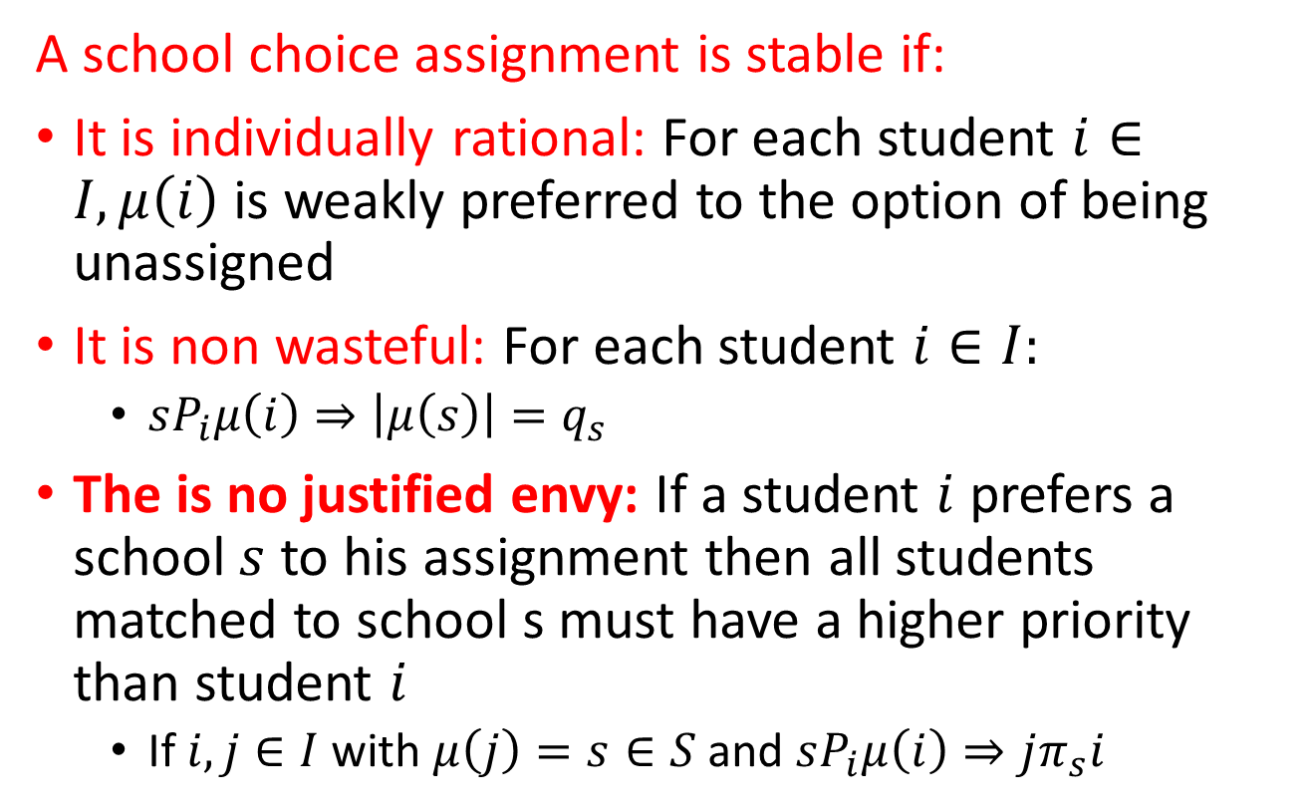
School Choice Stability
A school choice assignment is stable if:
It is individually rational: For each student $i∈I, μ\left(i\right)$ is weakly preferred to the option of being unassigned
It is non wasteful: For each student $i∈I:$
  $sP_{i}μ\left(i\right)⇒\left|μ\left(s\right)\right|=q_{s}$
The is no justified envy: If a student $i$ prefers a school $s$ to his assignment then all students matched to school s must have a higher priority than student $i$
  If $i,j∈I$ with $μ\left(j\right)=s∈S$ and $sP_{i}μ\left(i\right)⇒jπ_{s}i$

Slide 7
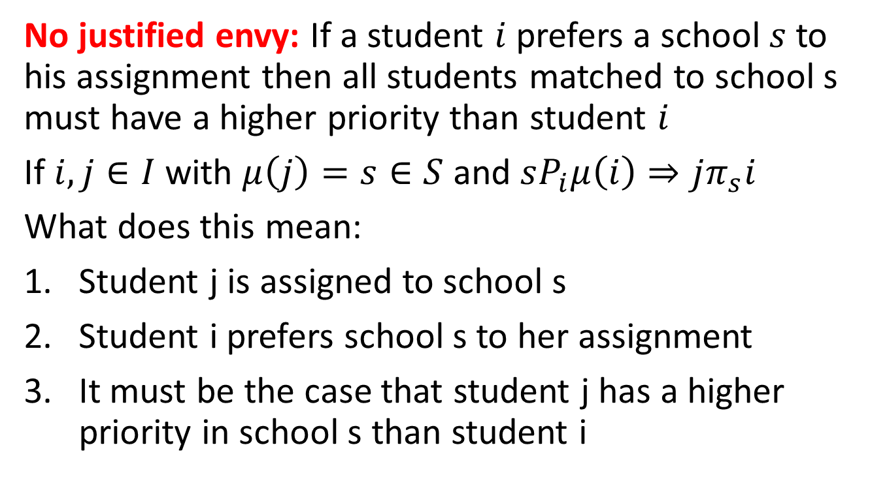
Justified envy
No justified envy: If a student $i$ prefers a school $s$ to his assignment then all students matched to school s must have a higher priority than student $i$
If $i,j∈I$ with $μ\left(j\right)=s∈S$ and $sP_{i}μ\left(i\right)⇒jπ_{s}i$
What does this mean:
Student j is assigned to school s
Student i prefers school s to her assignment
It must be the case that student j has a higher priority in school s than student i
1
2
3

Slide 8
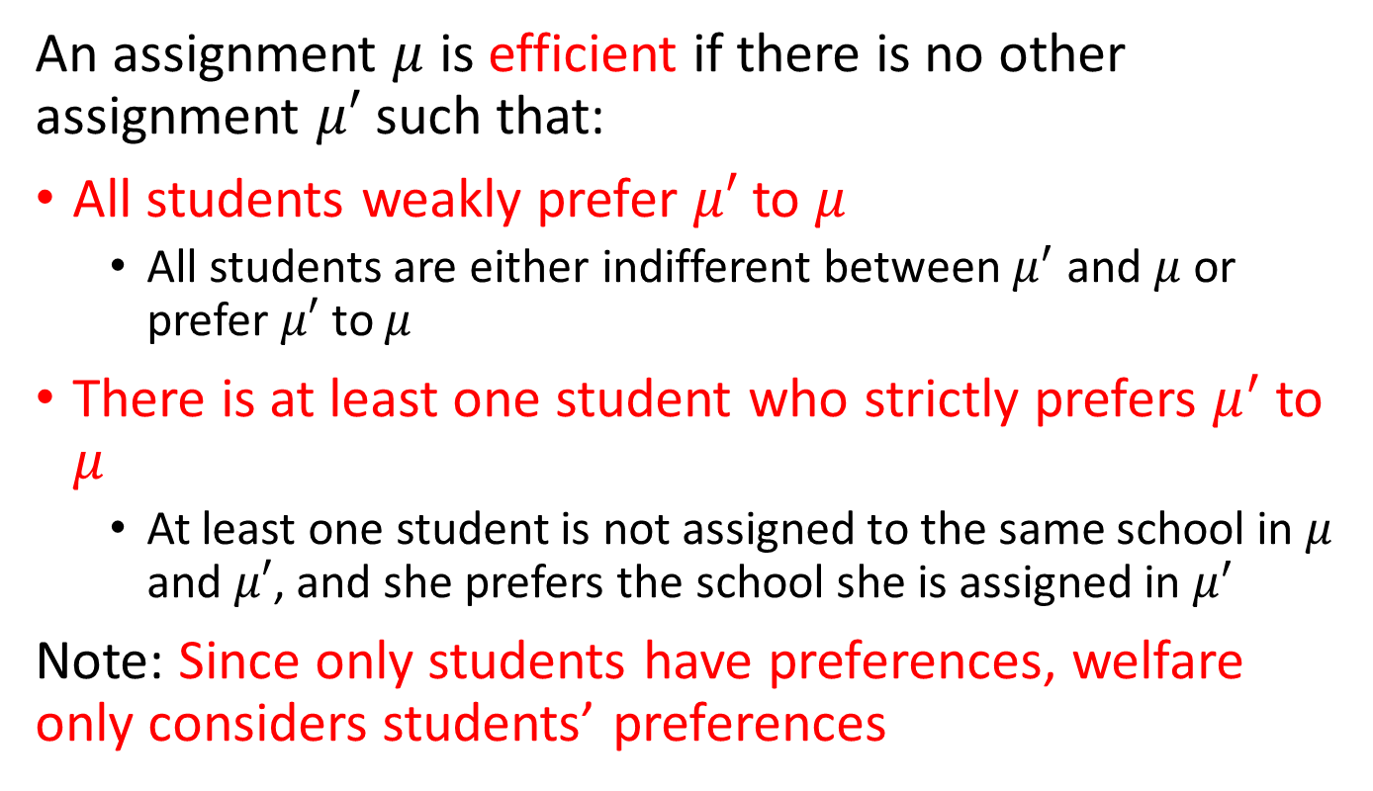
Efficiency in School Choice
An assignment $μ$ is efficient if there is no other assignment $μ′$ such that:
All students weakly prefer $μ′$ to $μ$
  All students are either indifferent between $μ^{′}$ and $μ$ or prefer $μ′$ to $μ$
There is at least one student who strictly prefers $μ^{′}$ to $μ$
  At least one student is not assigned to the same school in $μ$ and $μ′$, and she prefers the school she is assigned in $μ^{′}$
Note: Since only students have preferences, welfare only considers students’ preferences

Slide 9
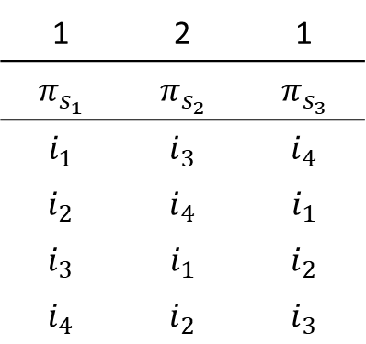
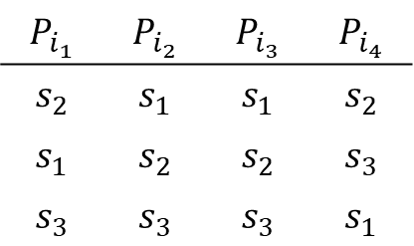

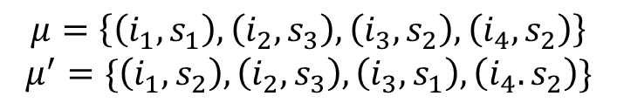
PollEV
1 | 2 | 1
$$π_{s_{1}}$$ | $$π_{s_{2}}$$ | $$π_{s_{3}}$$
$$i_{1}$$ | $$i_{3}$$ | $$i_{4}$$
$$i_{2}$$ | $$i_{4}$$ | $$i_{1}$$
$$i_{3}$$ | $$i_{1}$$ | $$i_{2}$$
$$i_{4}$$ | $$i_{2}$$ | $$i_{3}$$
Capacity
$$P_{i_{1}}$$ | $$P_{i_{2}}$$ | $$P_{i_{3}}$$ | $$P_{i_{4}}$$
$$s_{2}$$ | $$s_{1}$$ | $$s_{1}$$ | $$s_{2}$$
$$s_{1}$$ | $$s_{2}$$ | $$s_{2}$$ | $$s_{3}$$
$$s_{3}$$ | $$s_{3}$$ | $$s_{3}$$ | $$s_{1}$$
$$μ=\left\{\left(i_{1},s_{1}\right),\left(i_{2},s_{3}\right),\left(i_{3},s_{2}\right),\left(i_{4},s_{2}\right)\right\}$$
$$μ^{′}=\{\left(i_{1},s_{2}\right),\left(i_{2},s_{3}\right),\left(i_{3},s_{1}\right),\left(i_{4}.s_{2}\right)\}$$
Are $μ$ and $μ′$ efficient?

Slide 10
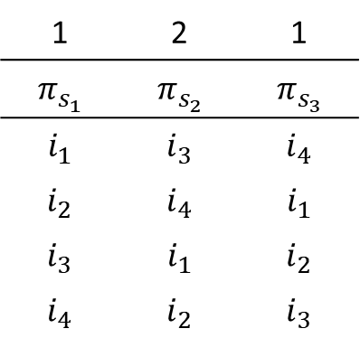
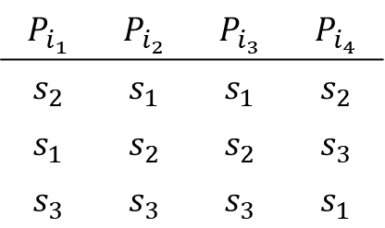

PollEV
1 | 2 | 1
$$π_{s_{1}}$$ | $$π_{s_{2}}$$ | $$π_{s_{3}}$$
$$i_{1}$$ | $$i_{3}$$ | $$i_{4}$$
$$i_{2}$$ | $$i_{4}$$ | $$i_{1}$$
$$i_{3}$$ | $$i_{1}$$ | $$i_{2}$$
$$i_{4}$$ | $$i_{2}$$ | $$i_{3}$$
Capacity
$$P_{i_{1}}$$ | $$P_{i_{2}}$$ | $$P_{i_{3}}$$ | $$P_{i_{4}}$$
$$s_{2}$$ | $$s_{1}$$ | $$s_{1}$$ | $$s_{2}$$
$$s_{1}$$ | $$s_{2}$$ | $$s_{2}$$ | $$s_{3}$$
$$s_{3}$$ | $$s_{3}$$ | $$s_{3}$$ | $$s_{1}$$
$$μ=\left\{\left(i_{1},s_{1}\right),\left(i_{2},s_{3}\right),\left(i_{3},s_{2}\right),\left(i_{4},s_{2}\right)\right\}$$
$$μ^{′}=\{\left(i_{1},s_{2}\right),\left(i_{2},s_{3}\right),\left(i_{3},s_{1}\right),\left(i_{4}.s_{2}\right)\}$$
Are $μ$ and $μ′$ stable?

Slide 11
Stability vs Efficiency
Theorem:
It may happen that, for some specific preferences and priorities, a stable matching is also efficient
But this is not true in general: It is impossible to guarantee that a matching is efficient and stable at the same time
Thus: Stability and efficiency are incompatible.

Slide 12
Stability and Efficiency
If there is a problem where stability and efficiency coincide, can we select the right matching?
Unfortunately, NO!
Theorem:
There is no efficient and strategy-proof mechanism that selects the efficient and stable matching whenever it exists.

Slide 13
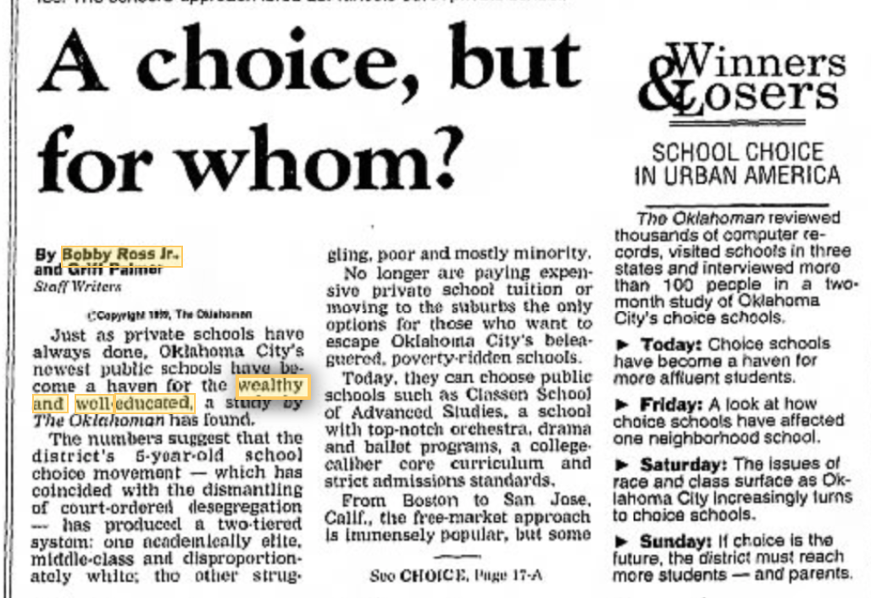

Slide 14
Choosing an Algorithm
The literature on School Choice started with the work of Abdulkadiroğlu and Sönmez
They were motivated by how school matching worked in Boston
Parents submitted a list of preferences to a clearinghouse and an algorithm was used to match students to schools
Boston was using the Immediate Acceptance algorithm

Slide 15
Other Algorithms
We can also use deferred acceptance or top trading cycles
In these algorithms, each side has a role
  One side proposes, the other side accepts/rejects
  Depending on which side is assigned which role, the assignment may be different
In the school choice problem, the roles are clear. Schools don’t have preferences:
  DA: Students propose
  TTC: Students are assigned what they point to when they are in a cycle

Slide 16
Deferred Acceptance
Works similar to the medical match:
Students propose to schools in order of their preferences
Schools accepts/rejects students’ proposals
The outcome is the student-optimal assignment and it has the usual properties:
DA is strategyproof for the students
The student-optimal assignment is students’ most preferred stable matching

Slide 17
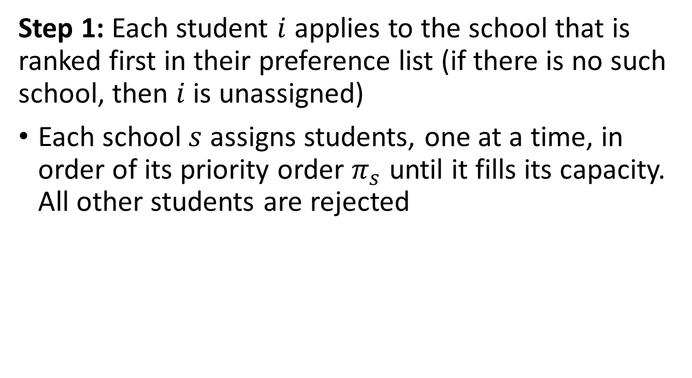
Deferred Acceptance
Step 1: Each student $i$ applies to the school that is ranked first in their preference list (if there is no such school, then $i$ is unassigned)
Each school $s$ assigns students, one at a time, in order of its priority order $π_{s}$ until it fills its capacity. All other students are rejected

Slide 18
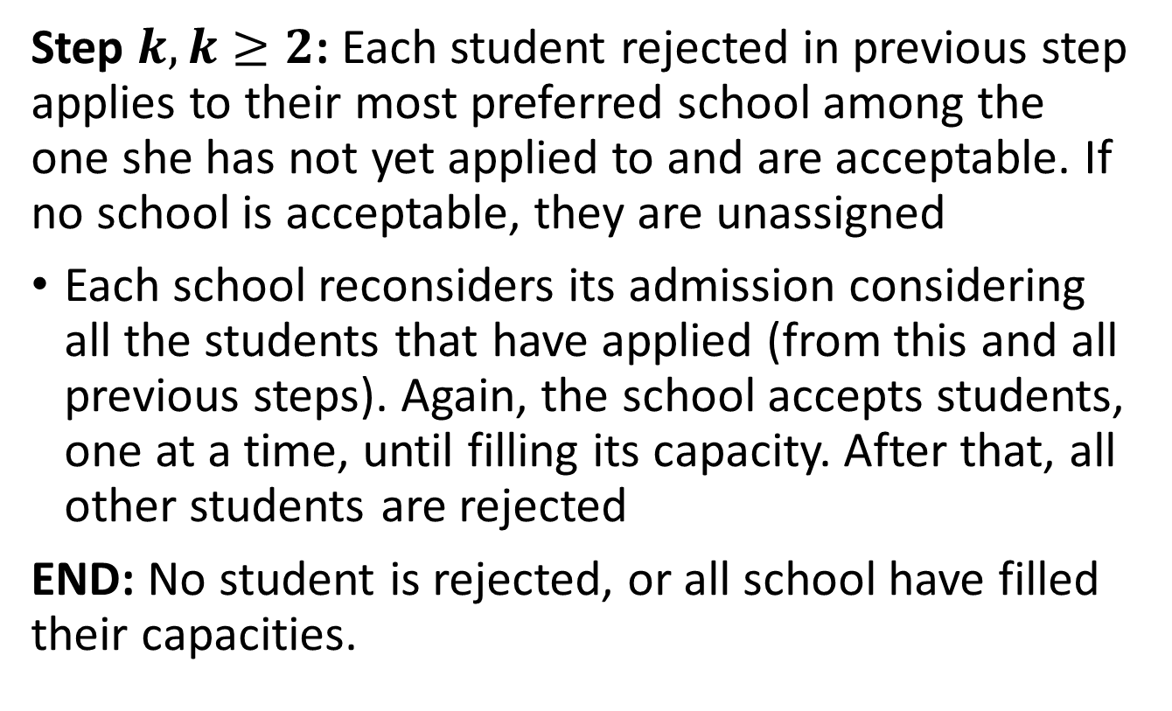
Deferred Acceptance
Step $k, k≥2$: Each student rejected in previous step applies to their most preferred school among the one she has not yet applied to and are acceptable. If no school is acceptable, they are unassigned
Each school reconsiders its admission considering all the students that have applied (from this and all previous steps). Again, the school accepts students, one at a time, until filling its capacity. After that, all other students are rejected
END: No student is rejected, or all school have filled their capacities.

Slide 19
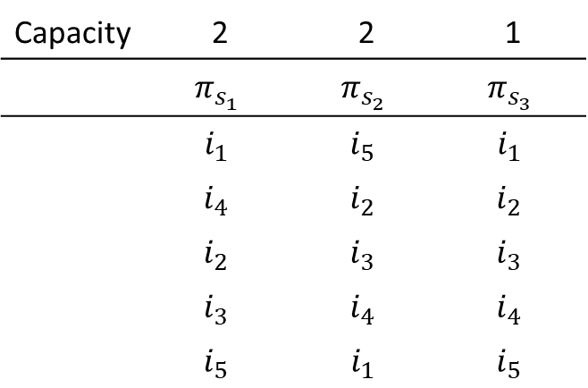
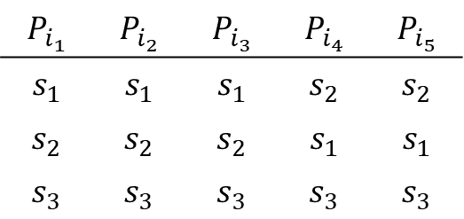
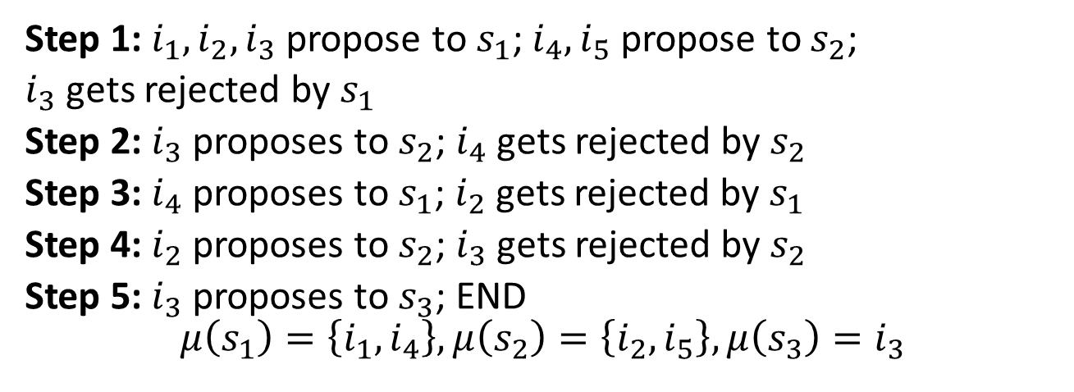
Example 2 (DA)
Capacity | 2 | 2 | 1
 | $$π_{s_{1}}$$ | $$π_{s_{2}}$$ | $$π_{s_{3}}$$
 | $$i_{1}$$ | $$i_{5}$$ | $$i_{1}$$
 | $$i_{4}$$ | $$i_{2}$$ | $$i_{2}$$
 | $$i_{2}$$ | $$i_{3}$$ | $$i_{3}$$
 | $$i_{3}$$ | $$i_{4}$$ | $$i_{4}$$
 | $$i_{5}$$ | $$i_{1}$$ | $$i_{5}$$
$$P_{i_{1}}$$ | $$P_{i_{2}}$$ | $$P_{i_{3}}$$ | $$P_{i_{4}}$$ | $$P_{i_{5}}$$
$$s_{1}$$ | $$s_{1}$$ | $$s_{1}$$ | $$s_{2}$$ | $$s_{2}$$
$$s_{2}$$ | $$s_{2}$$ | $$s_{2}$$ | $$s_{1}$$ | $$s_{1}$$
$$s_{3}$$ | $$s_{3}$$ | $$s_{3}$$ | $$s_{3}$$ | $$s_{3}$$
Step 1: $i_{1}, i_{2}, i_{3}$ propose to $s_{1}$; $i_{4}, i_{5}$ propose to $s_{2}$;
$i_{3}$ gets rejected by $s_{1}$
Step 2: $i_{3}$ proposes to $s_{2}$; $i_{4}$ gets rejected by $s_{2}$
Step 3: $i_{4}$ proposes to $s_{1}$; $i_{2}$ gets rejected by $s_{1}$
Step 4: $i_{2}$ proposes to $s_{2}$; $i_{3}$ gets rejected by $s_{2}$
Step 5: $i_{3}$ proposes to $s_{3}$; END
$$μ\left(s_{1}\right)=\left\{i_{1},i_{4}\right\},μ\left(s_{2}\right)=\left\{i_{2},i_{5}\right\},μ\left(s_{3}\right)=i_{3}$$

Slide 20
Immediate Acceptance
In Boston (and several other places), they used the immediate acceptance (IA) algorithm
IA is similar to DA:
  Students propose to schools in order of preferences
  Schools accept/reject students
  BUT: Schools’ acceptance decisions are definitive. Once a student is accepted by a school, they cannot be rejected at a later step

Slide 21
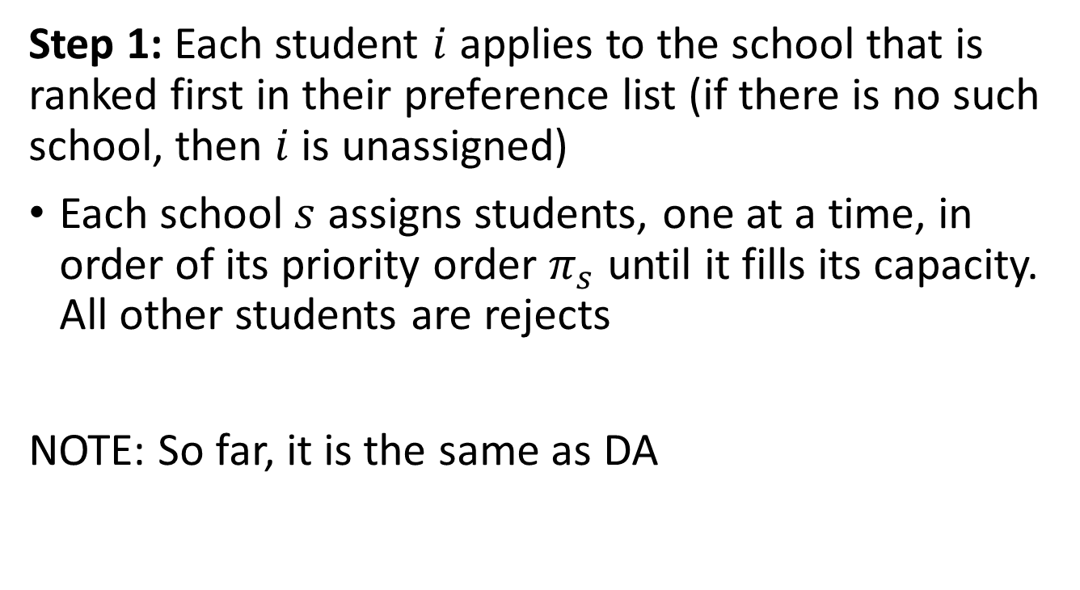
Immediate Acceptance
Step 1: Each student $i$ applies to the school that is ranked first in their preference list (if there is no such school, then $i$ is unassigned)
Each school $s$ assigns students, one at a time, in order of its priority order $π_{s}$ until it fills its capacity. All other students are rejects
NOTE: So far, it is the same as DA

Slide 22
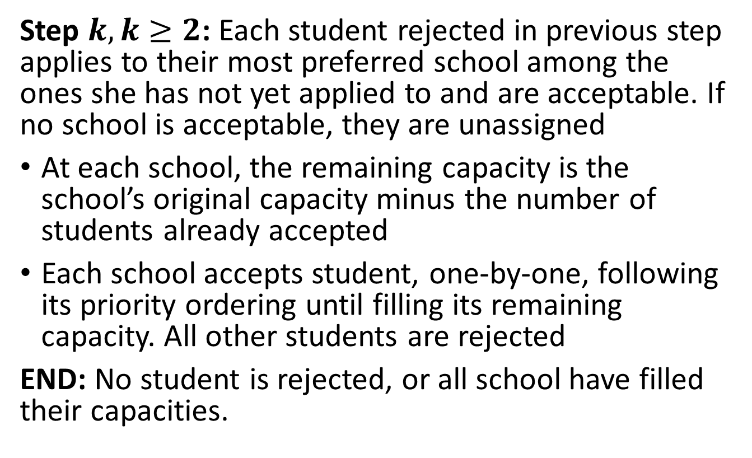
Immediate Acceptance
Step $k, k≥2$: Each student rejected in previous step applies to their most preferred school among the ones she has not yet applied to and are acceptable. If no school is acceptable, they are unassigned
At each school, the remaining capacity is the school’s original capacity minus the number of students already accepted
Each school accepts student, one-by-one, following its priority ordering until filling its remaining capacity. All other students are rejected
END: No student is rejected, or all school have filled their capacities.

Slide 23
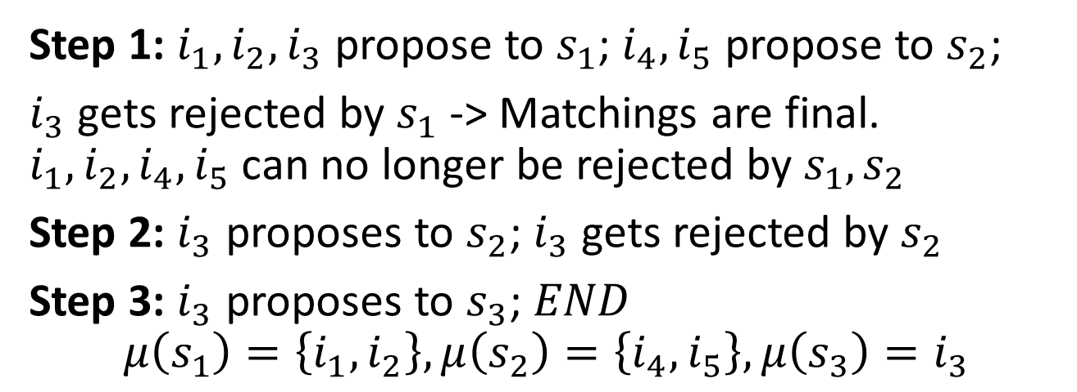
Example 3 (IA)
Capacity | 2 | 2 | 1
 | $$π_{s_{1}}$$ | $$π_{s_{2}}$$ | $$π_{s_{3}}$$
 | $$i_{1}$$ | $$i_{5}$$ | $$i_{1}$$
 | $$i_{4}$$ | $$i_{2}$$ | $$i_{2}$$
 | $$i_{2}$$ | $$i_{3}$$ | $$i_{3}$$
 | $$i_{3}$$ | $$i_{4}$$ | $$i_{4}$$
 | $$i_{5}$$ | $$i_{1}$$ | $$i_{5}$$
$$P_{i_{1}}$$ | $$P_{i_{2}}$$ | $$P_{i_{3}}$$ | $$P_{i_{4}}$$ | $$P_{i_{5}}$$
$$s_{1}$$ | $$s_{1}$$ | $$s_{1}$$ | $$s_{2}$$ | $$s_{2}$$
$$s_{2}$$ | $$s_{2}$$ | $$s_{2}$$ | $$s_{1}$$ | $$s_{1}$$
$$s_{3}$$ | $$s_{3}$$ | $$s_{3}$$ | $$s_{3}$$ | $$s_{3}$$
Step 1: $i_{1}, i_{2}, i_{3}$ propose to $s_{1}$; $i_{4}, i_{5}$ propose to $s_{2}$;
$i_{3}$ gets rejected by $s_{1}$ -> Matchings are final. $i_{1},i_{2},i_{4},i_{5}$ can no longer be rejected by $s_{1},s_{2}$
Step 2: $i_{3}$ proposes to $s_{2}$; $i_{3}$ gets rejected by $s_{2}$
Step 3: $i_{3}$ proposes to $s_{3}$; $END$
$$μ\left(s_{1}\right)=\left\{i_{1},i_{2}\right\},μ\left(s_{2}\right)=\left\{i_{4},i_{5}\right\},μ\left(s_{3}\right)=i_{3}$$

Slide 24
Top Trading Cycle
We need to introduce a few variation to the algorithm that we saw for room assignments
In TTC whenever a tenant and a room where in a cycle, they were assigned and removed from the problem
Now, objects can match multiple individuals. Thus, we don’t always remove the objects when in a cycle:
  Whenever a student is in a cycle, we assign them to the school and remove them from the problem
  For the school, we decrease its capacity by one. If it is out of capacity, we remove it. If not, it stays with new capacity

Slide 25
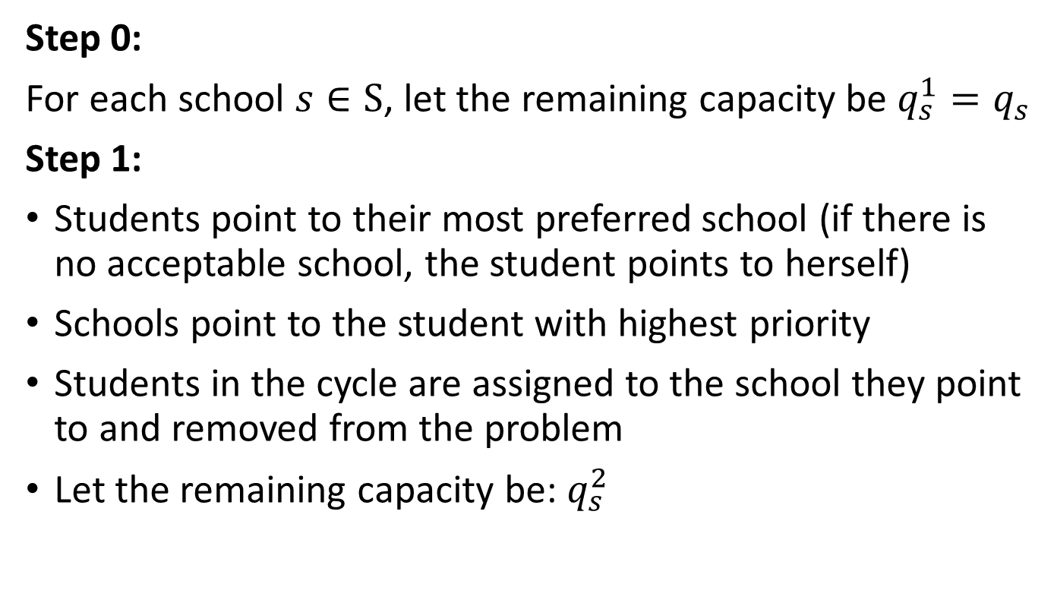
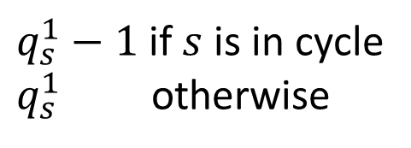
Top Trading Cycle
Step 0:
For each school $s∈S$, let the remaining capacity be $q_{s}^{1}=q_{s}$
Step 1:
Students point to their most preferred school (if there is no acceptable school, the student points to herself)
Schools point to the student with highest priority
Students in the cycle are assigned to the school they point to and removed from the problem
Let the remaining capacity be: $q_{s}^{2}$
$q_{s}^{1}−1$ if $s$ is in cycle
$q_{s}^{1}$ otherwise

Slide 26
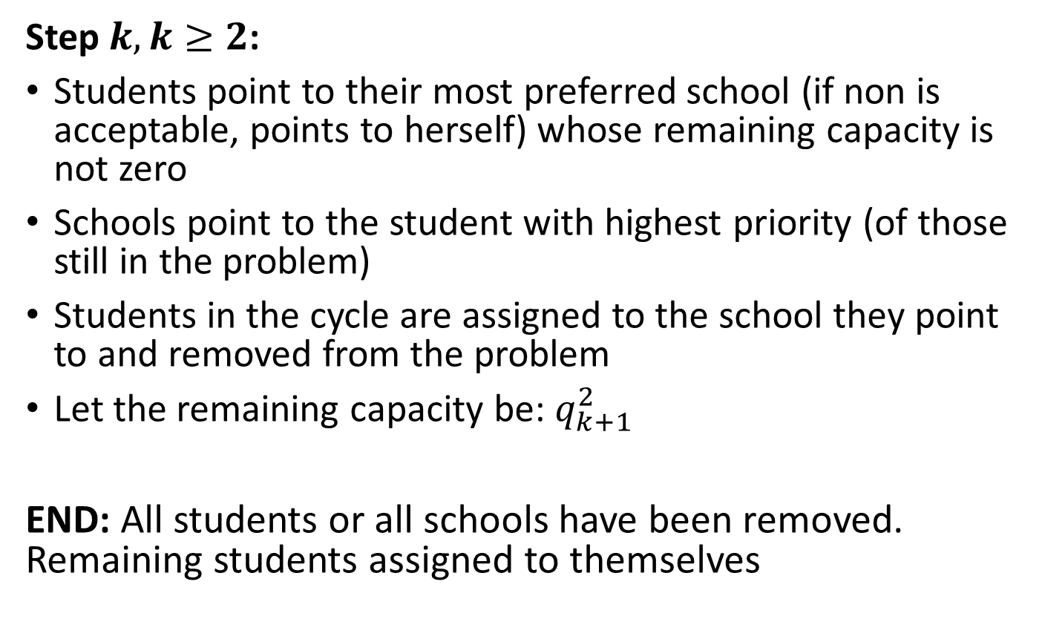
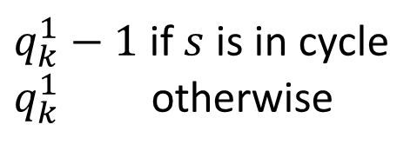
Top Trading Cycle (TTC)
Step $k,k≥2$:
Students point to their most preferred school (if non is acceptable, points to herself) whose remaining capacity is not zero
Schools point to the student with highest priority (of those still in the problem)
Students in the cycle are assigned to the school they point to and removed from the problem
Let the remaining capacity be: $q_{k+1}^{2}$
END: All students or all schools have been removed. Remaining students assigned to themselves
$q_{k}^{1}−1$ if $s$ is in cycle
$q_{k}^{1}$ otherwise

Slide 27
Example 4
Capacity | 2 | 2 | 1
 | $$π_{s_{1}}$$ | $$π_{s_{2}}$$ | $$π_{s_{3}}$$
 | $$i_{1}$$ | $$i_{5}$$ | $$i_{1}$$
 | $$i_{4}$$ | $$i_{2}$$ | $$i_{2}$$
 | $$i_{2}$$ | $$i_{3}$$ | $$i_{3}$$
 | $$i_{3}$$ | $$i_{4}$$ | $$i_{4}$$
 | $$i_{5}$$ | $$i_{1}$$ | $$i_{5}$$
$$P_{i_{1}}$$ | $$P_{i_{2}}$$ | $$P_{i_{3}}$$ | $$P_{i_{4}}$$ | $$P_{i_{5}}$$
$$s_{1}$$ | $$s_{1}$$ | $$s_{1}$$ | $$s_{2}$$ | $$s_{2}$$
$$s_{2}$$ | $$s_{2}$$ | $$s_{2}$$ | $$s_{1}$$ | $$s_{1}$$
$$s_{3}$$ | $$s_{3}$$ | $$s_{3}$$ | $$s_{3}$$ | $$s_{3}$$

Slide 28
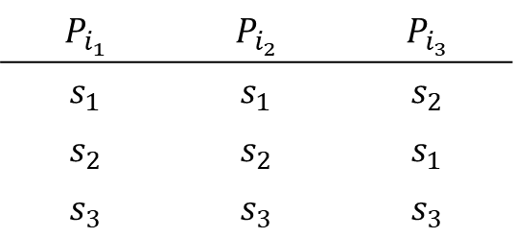
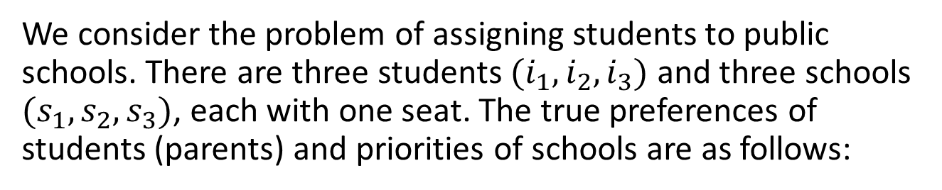
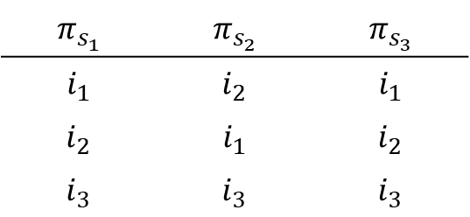
PollEV
We consider the problem of assigning students to public schools. There are three students ${(i}_{1},i_{2},i_{3})$ and three schools $(s_{1},s_{2},s_{3})$, each with one seat. The true preferences of students (parents) and priorities of schools are as follows:
$$P_{i_{1}}$$ | $$P_{i_{2}}$$ | $$P_{i_{3}}$$
$$s_{1}$$ | $$s_{1}$$ | $$s_{2}$$
$$s_{2}$$ | $$s_{2}$$ | $$s_{1}$$
$$s_{3}$$ | $$s_{3}$$ | $$s_{3}$$
$$π_{s_{1}}$$ | $$π_{s_{2}}$$ | $$π_{s_{3}}$$
$$i_{1}$$ | $$i_{2}$$ | $$i_{1}$$
$$i_{2}$$ | $$i_{1}$$ | $$i_{2}$$
$$i_{3}$$ | $$i_{3}$$ | $$i_{3}$$
Using the immediate acceptance algorithm with students proposing, and parents submitting their true preferences, find the school assignment

Slide 29
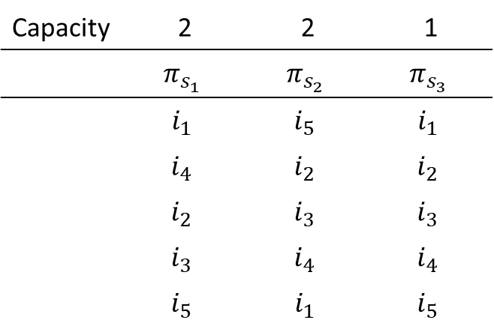
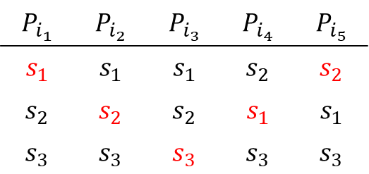
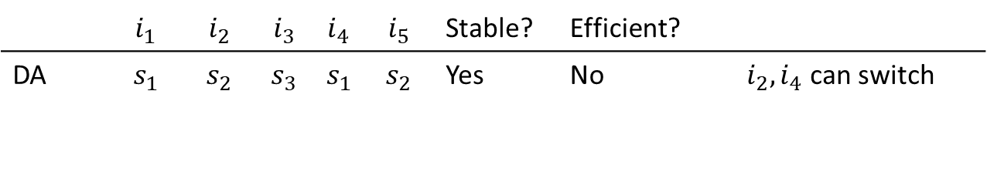
Comparing the assignments
Capacity | 2 | 2 | 1
 | $$π_{s_{1}}$$ | $$π_{s_{2}}$$ | $$π_{s_{3}}$$
 | $$i_{1}$$ | $$i_{5}$$ | $$i_{1}$$
 | $$i_{4}$$ | $$i_{2}$$ | $$i_{2}$$
 | $$i_{2}$$ | $$i_{3}$$ | $$i_{3}$$
 | $$i_{3}$$ | $$i_{4}$$ | $$i_{4}$$
 | $$i_{5}$$ | $$i_{1}$$ | $$i_{5}$$
$$P_{i_{1}}$$ | $$P_{i_{2}}$$ | $$P_{i_{3}}$$ | $$P_{i_{4}}$$ | $$P_{i_{5}}$$
$$s_{1}$$ | $$s_{1}$$ | $$s_{1}$$ | $$s_{2}$$ | $$s_{2}$$
$$s_{2}$$ | $$s_{2}$$ | $$s_{2}$$ | $$s_{1}$$ | $$s_{1}$$
$$s_{3}$$ | $$s_{3}$$ | $$s_{3}$$ | $$s_{3}$$ | $$s_{3}$$
 | $$i_{1}$$ | $$i_{2}$$ | $$i_{3}$$ | $$i_{4}$$ | $$i_{5}$$ | Stable? | Efficient?
DA | $$s_{1}$$ | $$s_{2}$$ | $$s_{3}$$ | $$s_{1}$$ | $$s_{2}$$ | Yes | No | $i_{2},i_{4}$ can switch

Slide 30
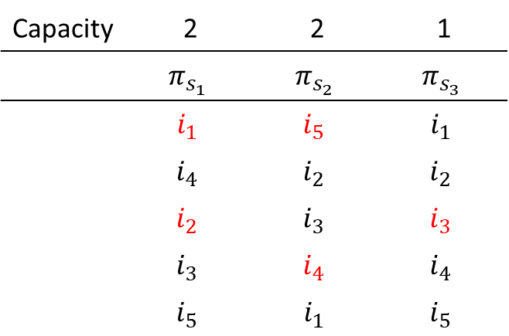
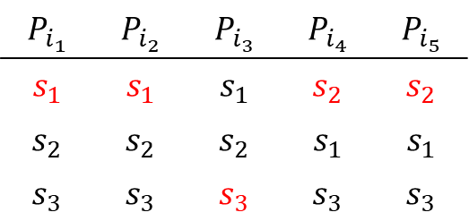
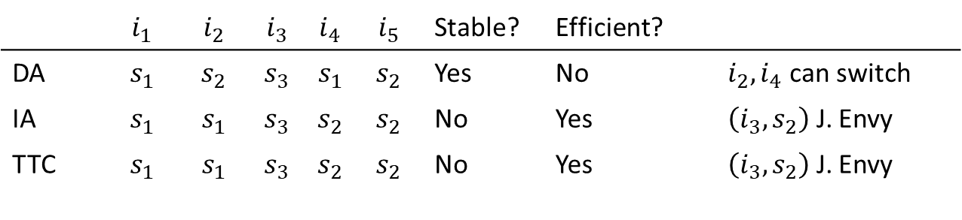
Comparing the Assignments
Capacity | 2 | 2 | 1
 | $$π_{s_{1}}$$ | $$π_{s_{2}}$$ | $$π_{s_{3}}$$
 | $$i_{1}$$ | $$i_{5}$$ | $$i_{1}$$
 | $$i_{4}$$ | $$i_{2}$$ | $$i_{2}$$
 | $$i_{2}$$ | $$i_{3}$$ | $$i_{3}$$
 | $$i_{3}$$ | $$i_{4}$$ | $$i_{4}$$
 | $$i_{5}$$ | $$i_{1}$$ | $$i_{5}$$
$$P_{i_{1}}$$ | $$P_{i_{2}}$$ | $$P_{i_{3}}$$ | $$P_{i_{4}}$$ | $$P_{i_{5}}$$
$$s_{1}$$ | $$s_{1}$$ | $$s_{1}$$ | $$s_{2}$$ | $$s_{2}$$
$$s_{2}$$ | $$s_{2}$$ | $$s_{2}$$ | $$s_{1}$$ | $$s_{1}$$
$$s_{3}$$ | $$s_{3}$$ | $$s_{3}$$ | $$s_{3}$$ | $$s_{3}$$
 | $$i_{1}$$ | $$i_{2}$$ | $$i_{3}$$ | $$i_{4}$$ | $$i_{5}$$ | Stable? | Efficient?
DA | $$s_{1}$$ | $$s_{2}$$ | $$s_{3}$$ | $$s_{1}$$ | $$s_{2}$$ | Yes | No | $i_{2},i_{4}$ can switch
IA | $$s_{1}$$ | $$s_{1}$$ | $$s_{3}$$ | $$s_{2}$$ | $$s_{2}$$ | No | Yes | $\left(i_{3},s_{2}\right)$ J. Envy
TTC | $$s_{1}$$ | $$s_{1}$$ | $$s_{3}$$ | $$s_{2}$$ | $$s_{2}$$ | No | Yes | $\left(i_{3},s_{2}\right)$ J. Envy

Slide 31
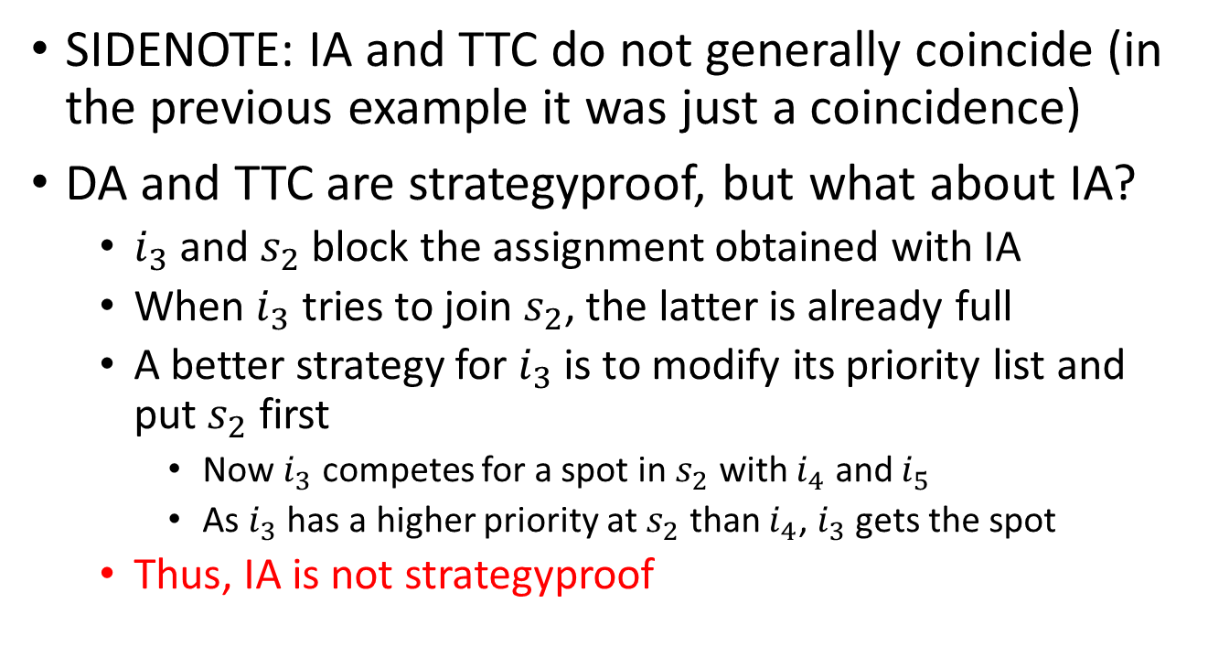
Comparing the Assignments
SIDENOTE: IA and TTC do not generally coincide (in the previous example it was just a coincidence)
DA and TTC are strategyproof, but what about IA?
  $i_{3}$ and $s_{2}$ block the assignment obtained with IA
  When $i_{3}$ tries to join $s_{2}$, the latter is already full
  A better strategy for $i_{3}$ is to modify its priority list and put $s_{2}$ first
    Now $i_{3}$ competes for a spot in $s_{2}$ with $i_{4}$ and $i_{5}$
    As $i_{3}$ has a higher priority at $s_{2}$ than $i_{4}$, $i_{3}$ gets the spot
  Thus, IA is not strategyproof

Slide 32
Popularity of Immediate Acceptance
IA is used in many cities
Politicians like IA because they can tout that the system is maximizing the number of students matched to their top choice
Economists say that argument is false, because:
Parents don’t report their true preferences. They need to be strategic and put a school they will believe they will get as their top choice
  i.e. Their reported top choice is not really their top choice

Slide 33
Choosing the right algorithm:
The cases of Boston and NYC
Boston and NYC have recently changed how they assign schools to students using contributions of the matching market literature
It is interesting to contrast both cases, as the characteristic of the schools at each city dictates different algorithms be used

Slide 34
The Boston School Match
In Fall 2003 Abdulkadiroğlu, Pathak, Roth and Sönmez were asked for recommendations to reform the Boston Public School matching system
Boston Public Schools were using the IA algorithm:
  Over 60,000 students in K-12
  Three zones: East, West, and North
  Assignments are done at these grades (2004 data):
    Entering Kindergarten: 4,800 students
    Entering 1st grade: 4,000 students
    Entering 6th grade: 4,300 students
    Entering 9th grade: 4,000 students

Slide 35
BPS School Priorities
School’s priorities at schools are set by the administrator using the following rules
  1st tier: Students with an older sibling attending the school
  2nd tier: Students living in the walk zone of the school (zones are defined by BPS)
  3rd tier: All other students
  Then:
    50% of a schools’ seats are prioritized according to the three tiers
    50% of a schools’ seats are not prioritized
  Priorities are made strict using a random draw

Slide 36
Which Algorithm should they use in Boston?
A first criterion is to use a strategyproof mechanism:
  If mechanism is not strategyproof, parents with a better understanding on how the assignment works may be able to “game” the system to obtain an unfair advantage (at the expense of others)
Then, we need to decide if we want efficiency or stability?
  Efficiency: Use TTC
  Stability: Use DA

Slide 37
Which Algorithm should they use in Boston?
Choosing DA or TTC depends on how we interpret schools’ priorities
  TTC implicitly assumes that students can trade their priorities
  In DA priorities are not tradable. Students have no ownership over priorities
Initially, the task force preferred TTC. However, at the end they decided to recommend DA
Boston started using DA in 2007

Slide 38
The NYC School Match
The case in NYC is different from Boston in several ways:
It is larger scale. More than 90k students and 900+ kindergarten options and 500+ different academic programs (high schools)
In Boston they were motivated by public opinion, which was starting to see the system as unfair
In NYC the problem was congestion: The match was decentralized, and students were restricted in the number of applications they could send
NYC Department of Education started discussing if something like the National Medical Match could be adapted

Slide 39
Which Algorithm should they use in NYC
Schools in NYC are not homogenous
  Some schools can screen students: For example, schools targeted to those with talents in art or with special needs
    These schools have preferences
  Other schools are more typical (like in Boston)
Evidence that schools were being strategic (in the decentralized procedure) indicates that this looks more like a matching problem than an assignment problem
  Thus, DA is the natural choice in NYC

Slide 40
DA with schools or with students proposing?
In a matching problem we can have students or schools propose when using DA
It quickly became clear that students proposing was better:
  DA is strategyproof for students when they propose. The matching it produces is the student-optimal matching
  In many-to-one problems there is no mechanism that is strategyproof for the schools and that produces stable matchings
    Strategyproof for schools means revealing true preferences and true capacities

Slide 41
DA in NYC
The first year that DA was using in NYC:
70,000 students matched to a school in their initial choice list (up from 50,000)
Unmatched students are asked to submit a new preference list
At the end, unmatched students are manually matched (to a school not on their preference list)
  Previous system: This happened to 30,000 students/yr
  With DA: 3,000 students/yr

Slide 42
Take Away
School choice is a many-to-one assignment problem
We would like to have efficiency and stability, but they are incompatible
  Stability can be obtained with DA (with students proposing). This is also strategyproof (for students)
  Efficiency can be obtained using TTC. Also strategyproof
Another popular algorithm is immediate acceptance. It produces an efficient matching. But it is not stable nor strategyproof
  And in general IA and TTC do not produce the same assignment

Slide 43
Take Away
Boston Public School used IA until 2006. In 2007 they switched to DA
  Problem was that IA was starting to be perceived as unfair as some people could game the system
  In Boston school choice is an assignment problem: Schools do not have preferences over students (but some students have priority)
NYC switched from a decentralized to a centralized matching system
  School choice in NYC looks more like a matching problem: Some schools were behaving strategically because they had preferences over students
  DA with students proposing was chosen for the matching mechanism

